Slide 1



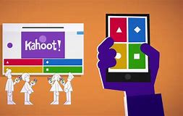
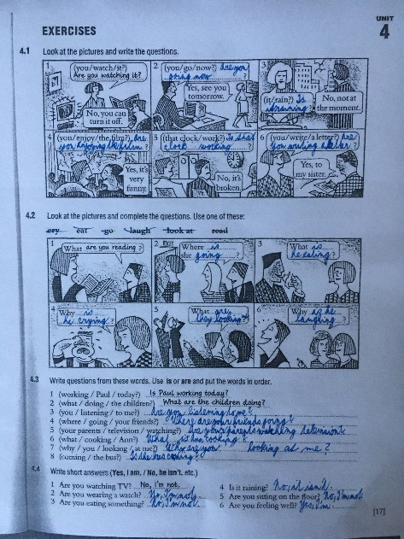
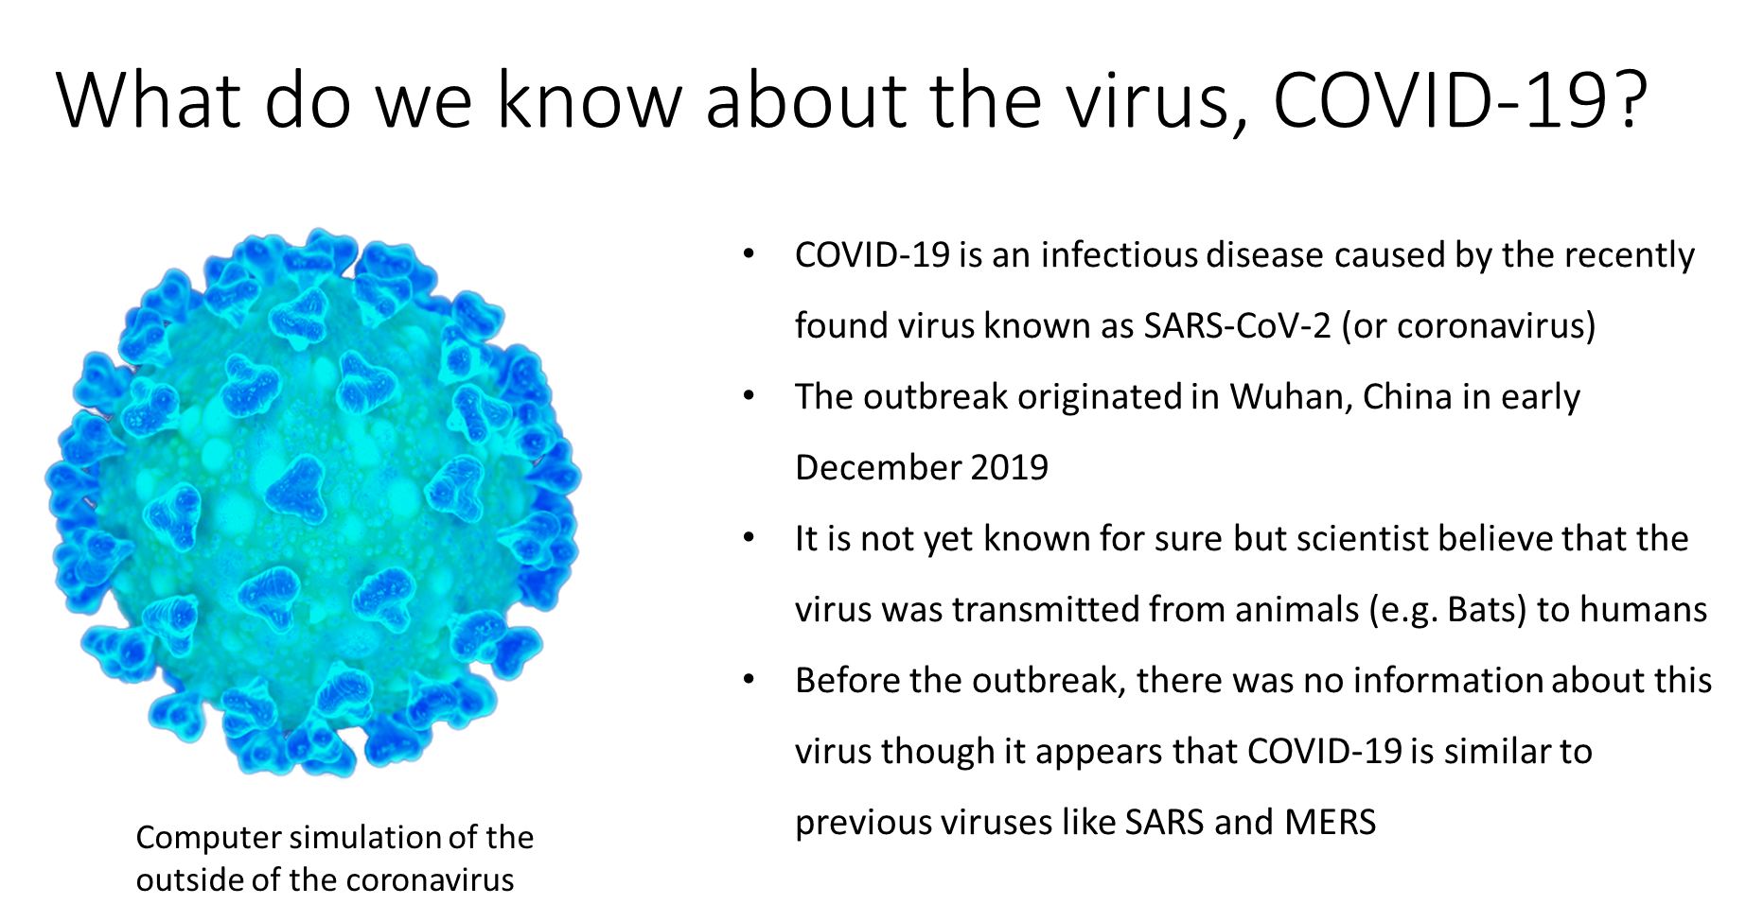
Google classroom
Umíme anglicky
Grammar
Quizes
Presentations

Slide 2
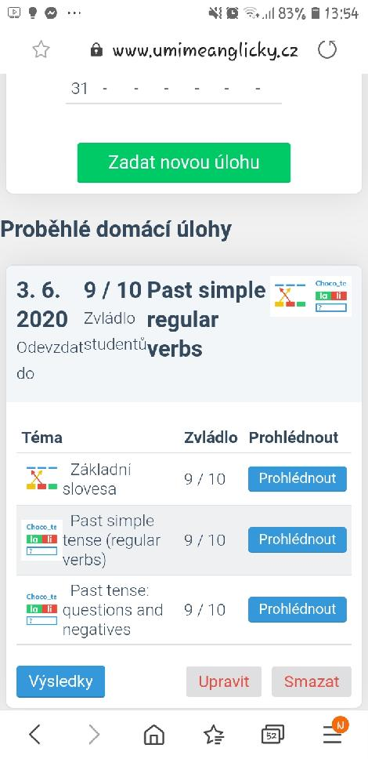
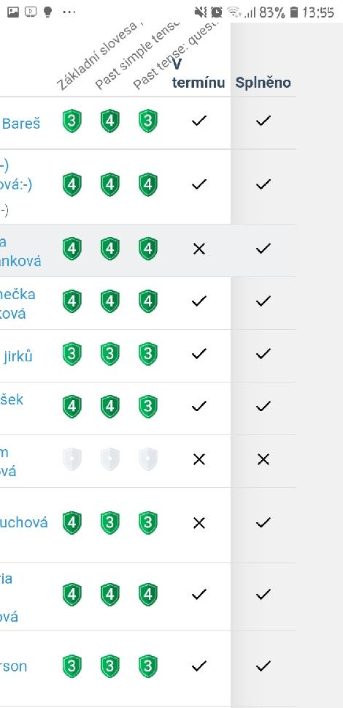
Umíme anglicky

Slide 3
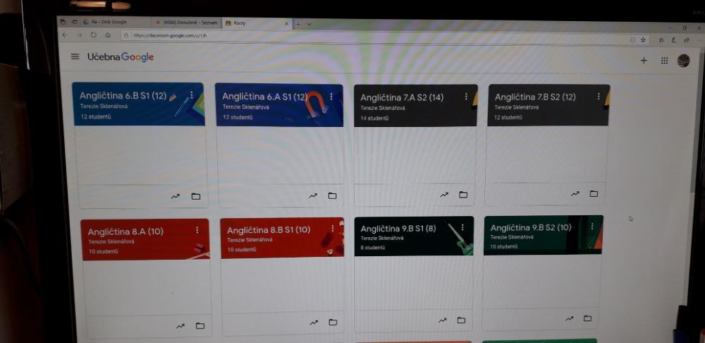
Google classroom

Slide 4

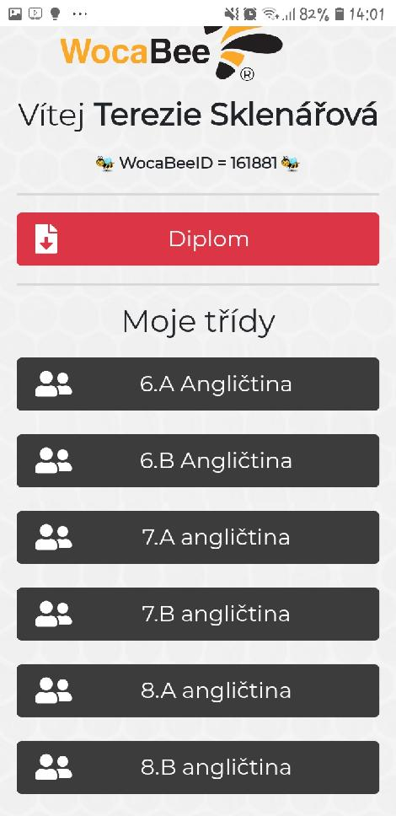
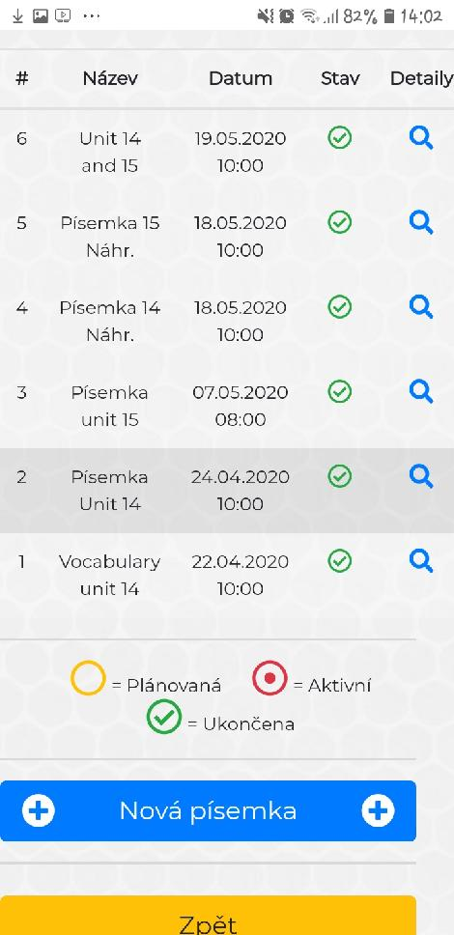

Slide 5

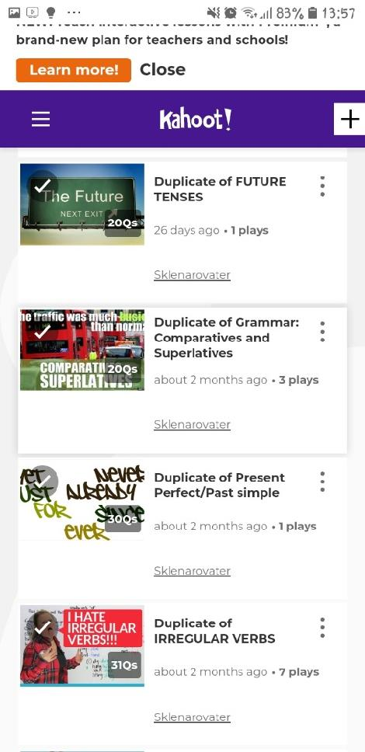
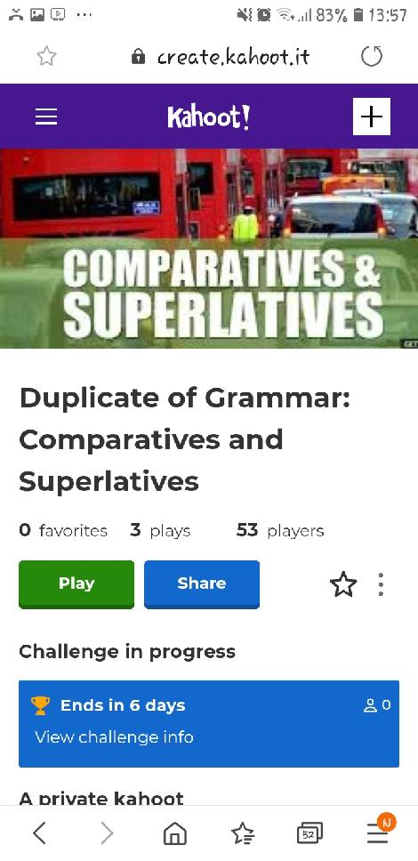

Slide 6
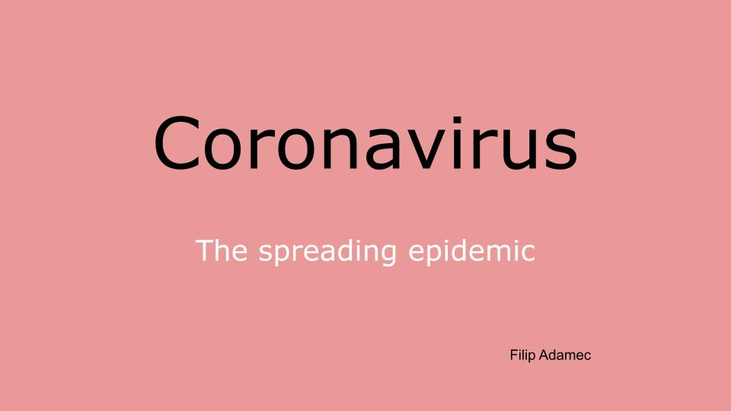
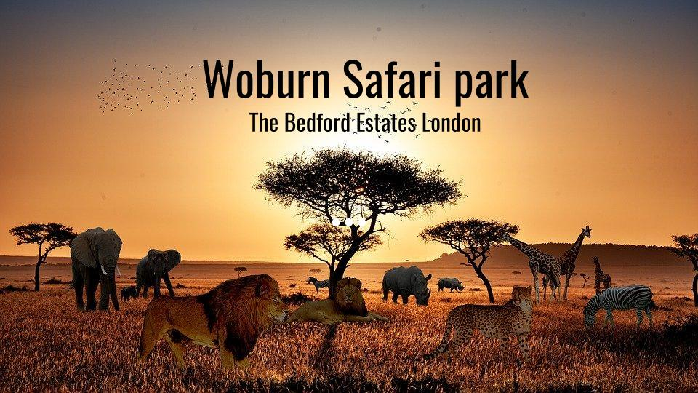
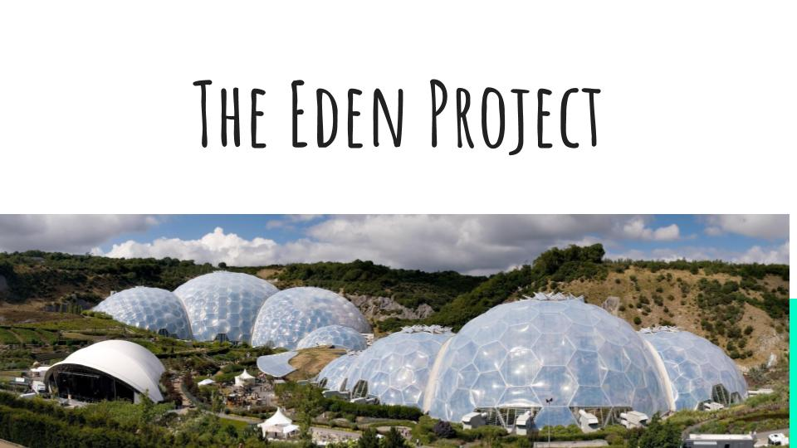

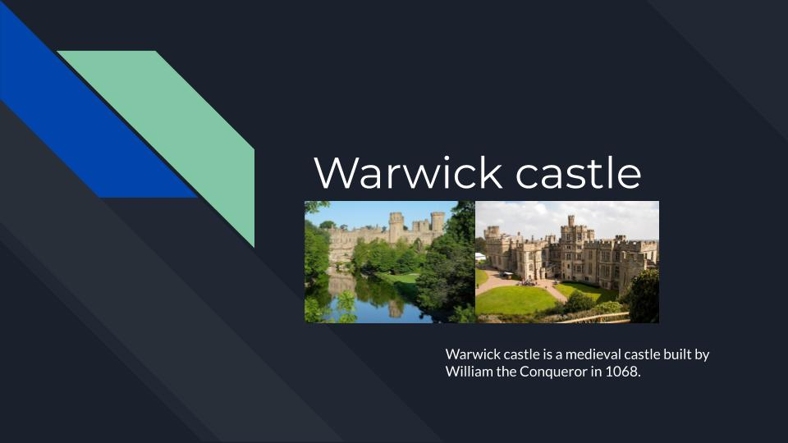
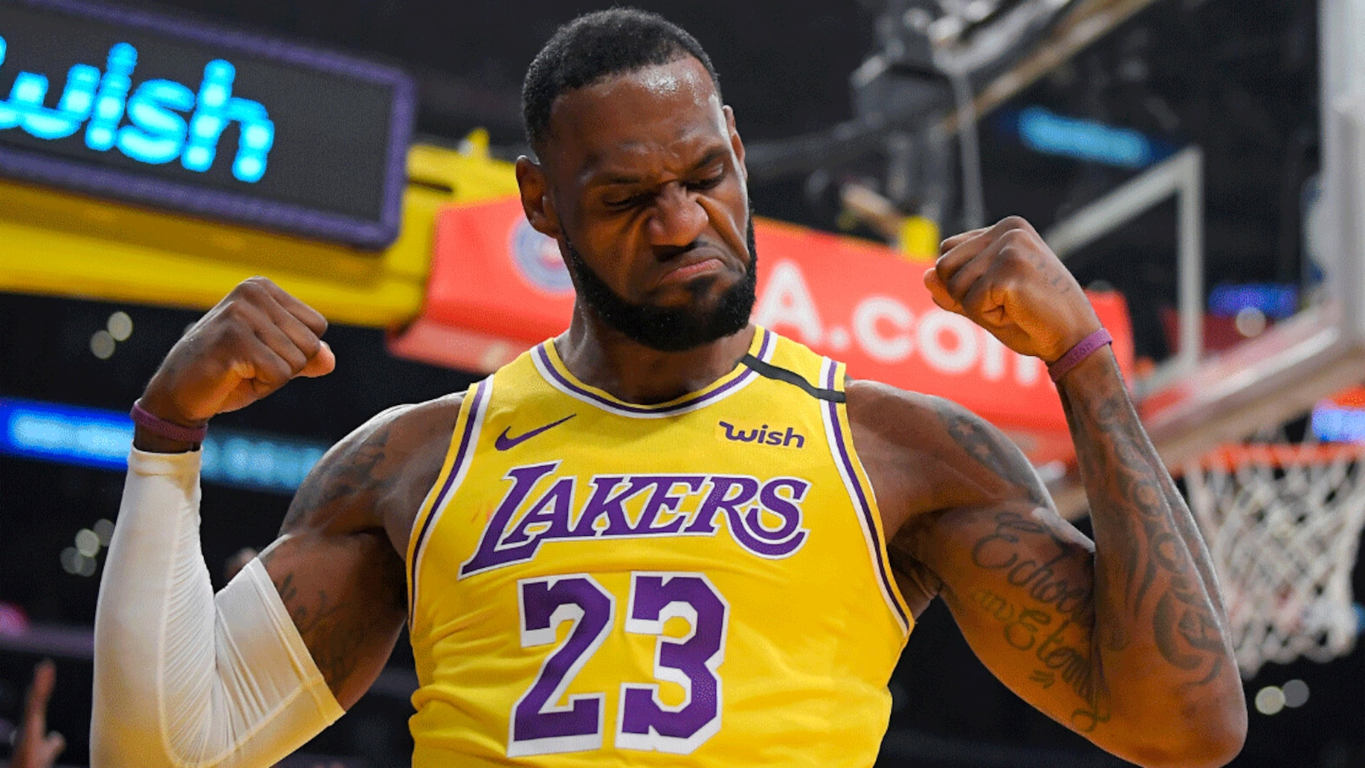
Presentations
Basketball :

Slide 7
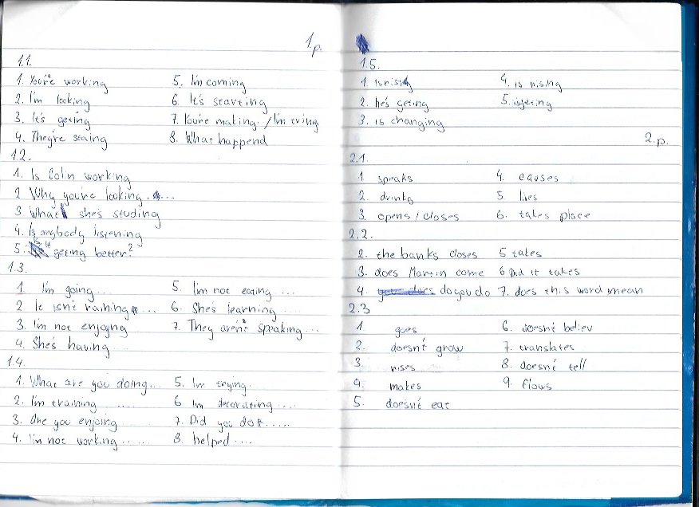
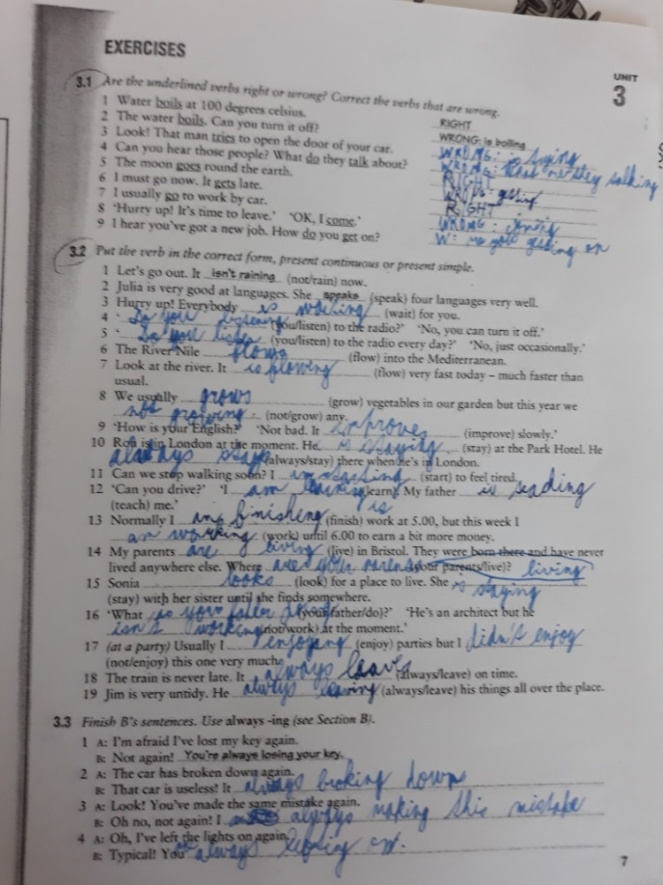
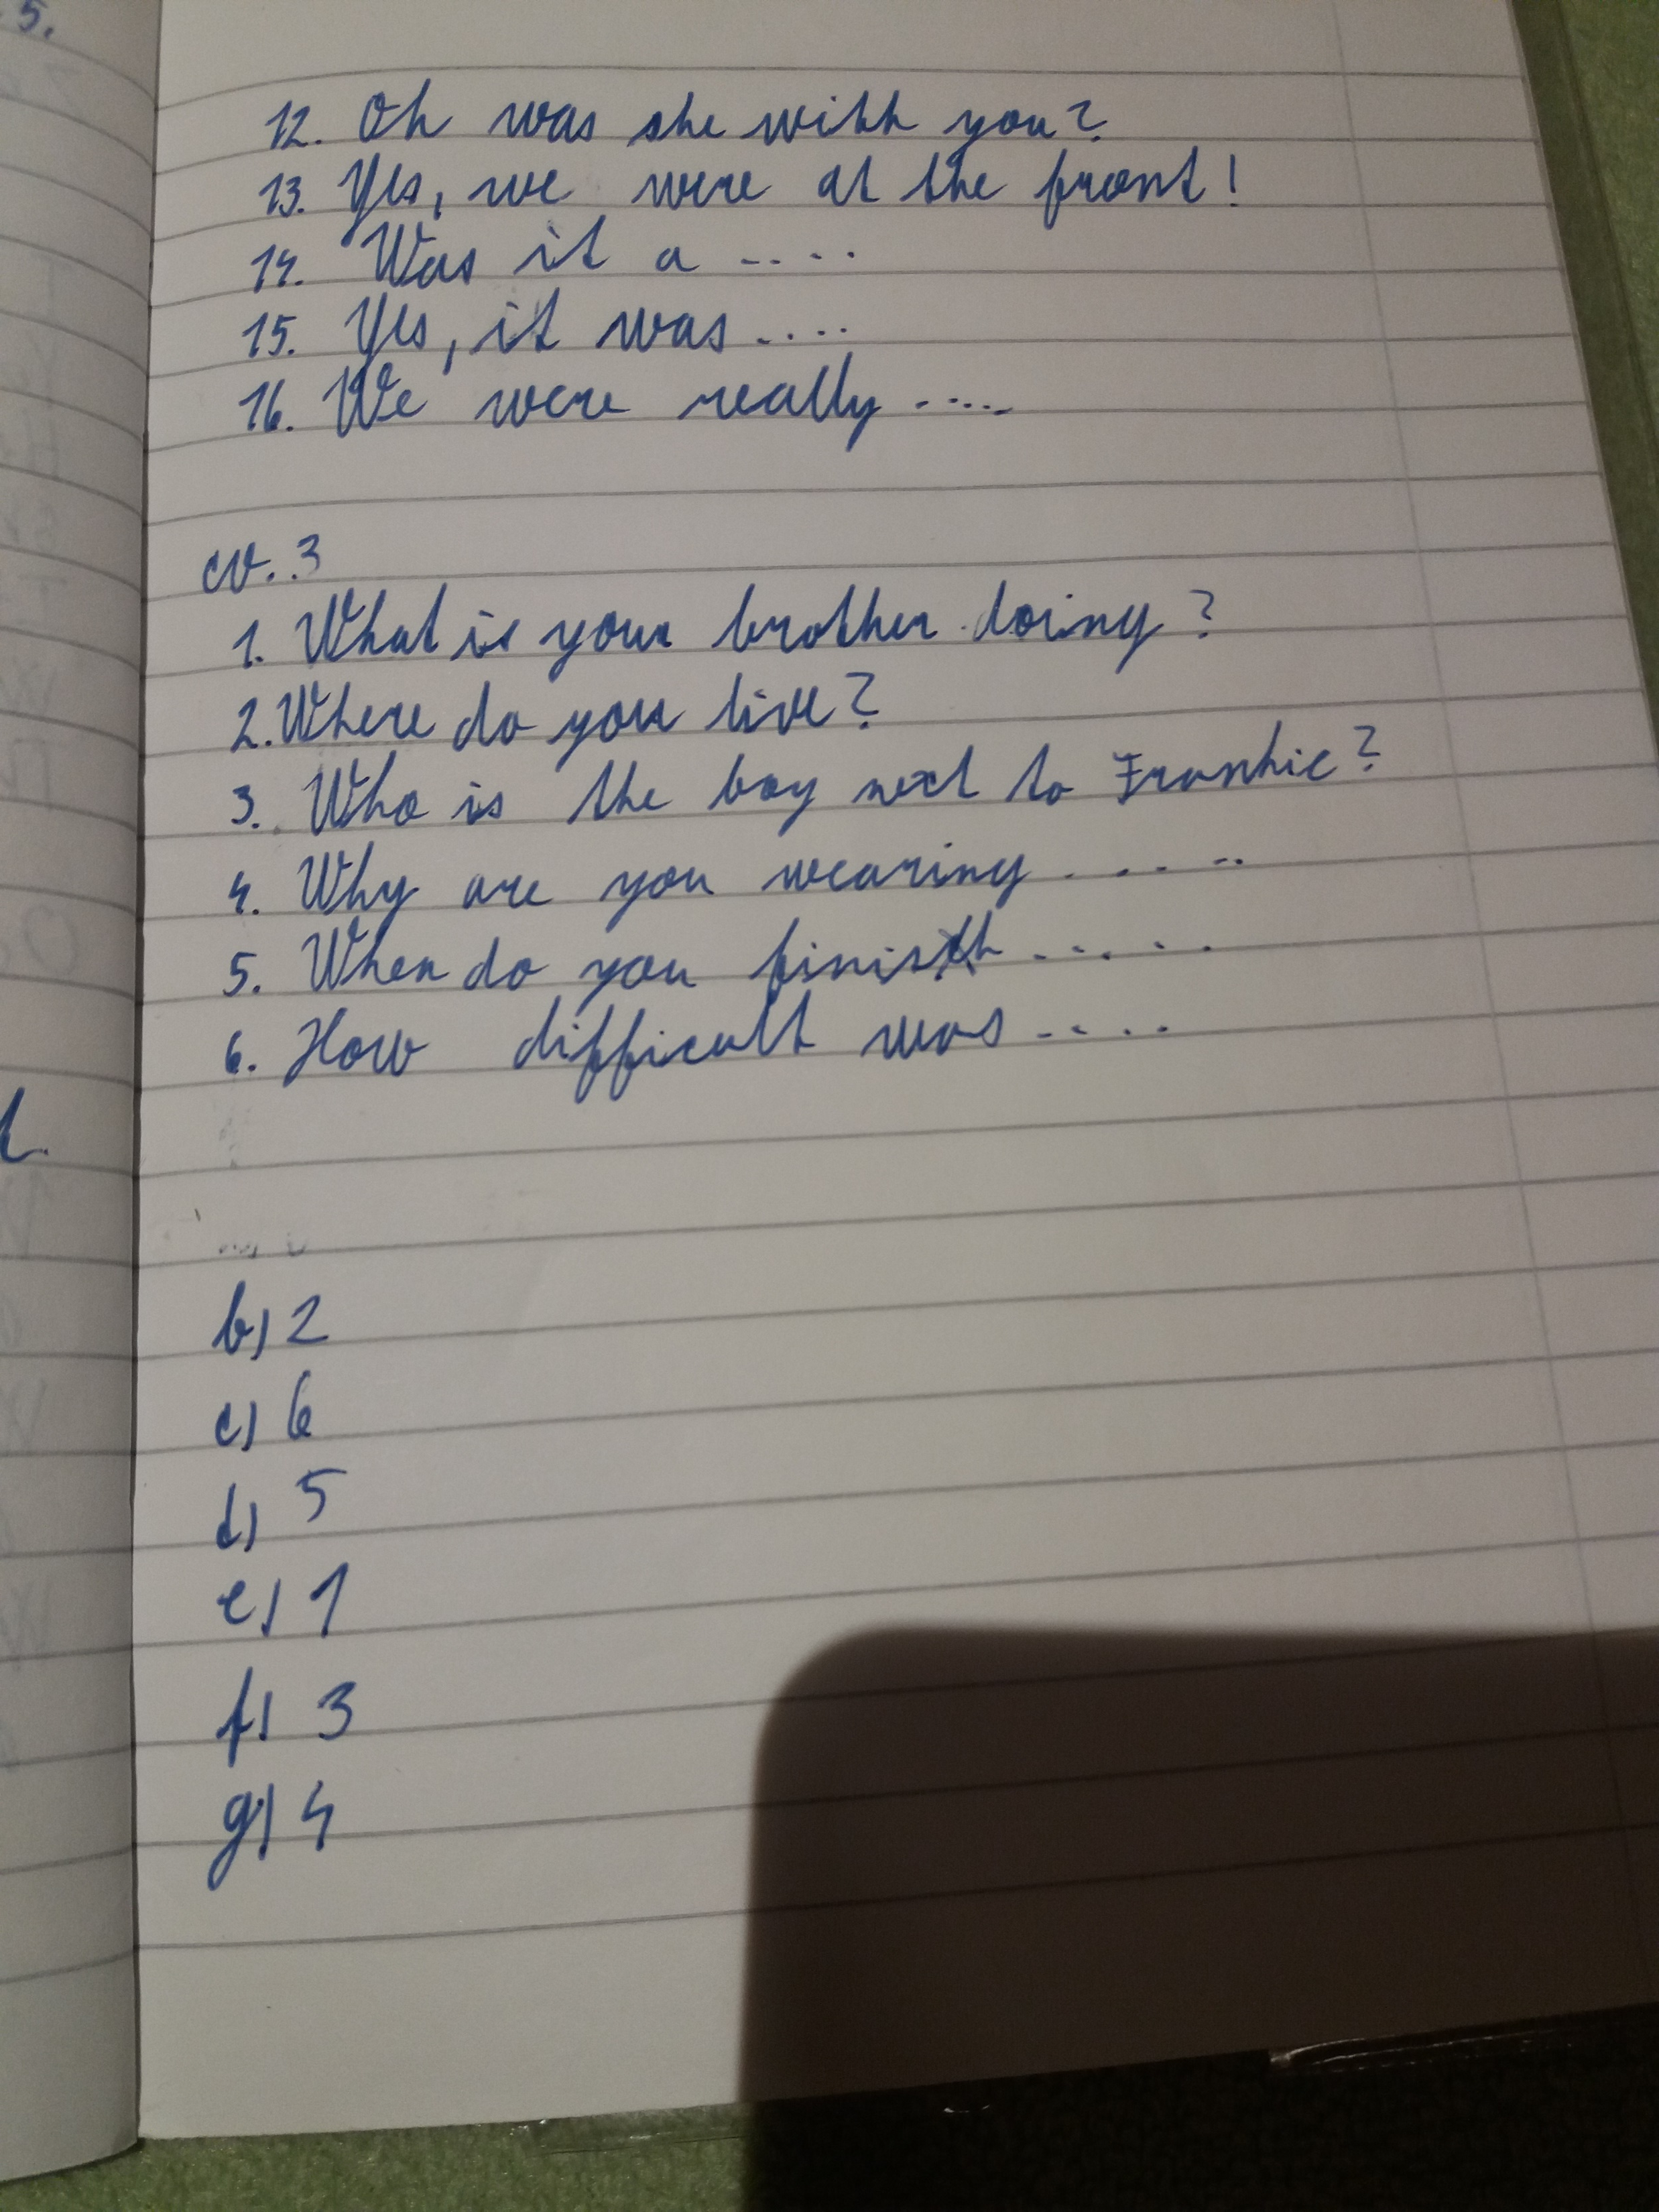
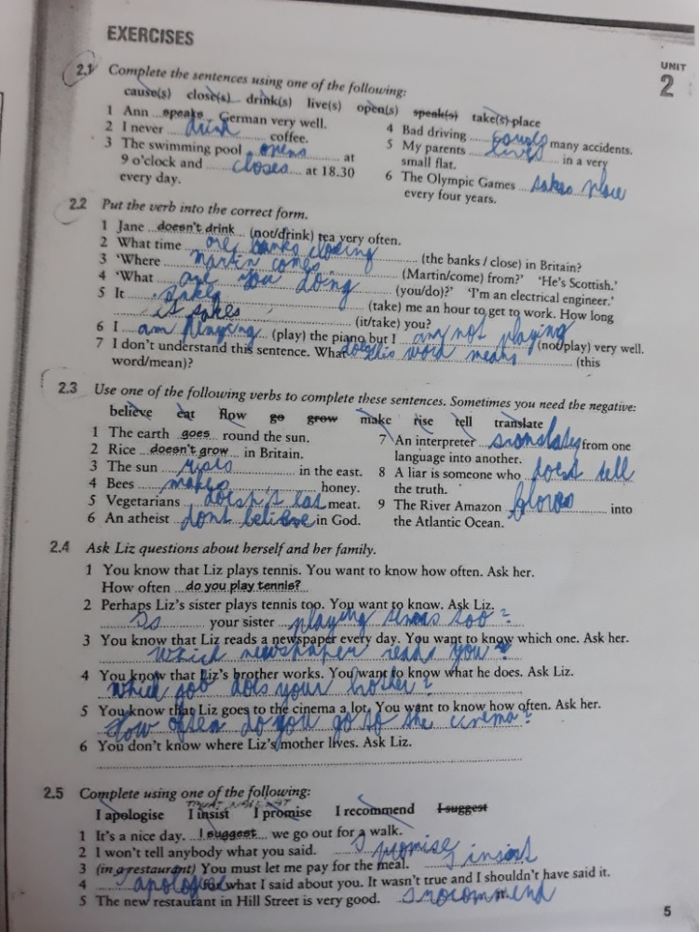
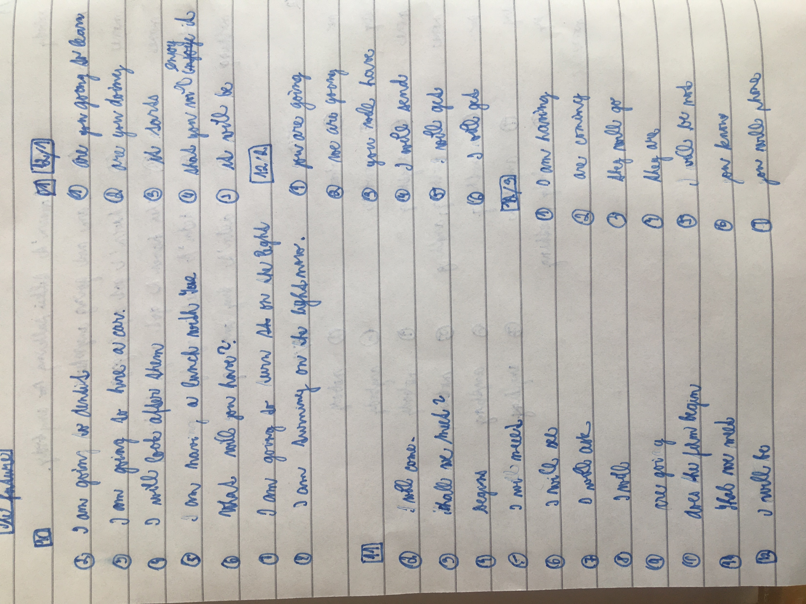
Grammar

Slide 8
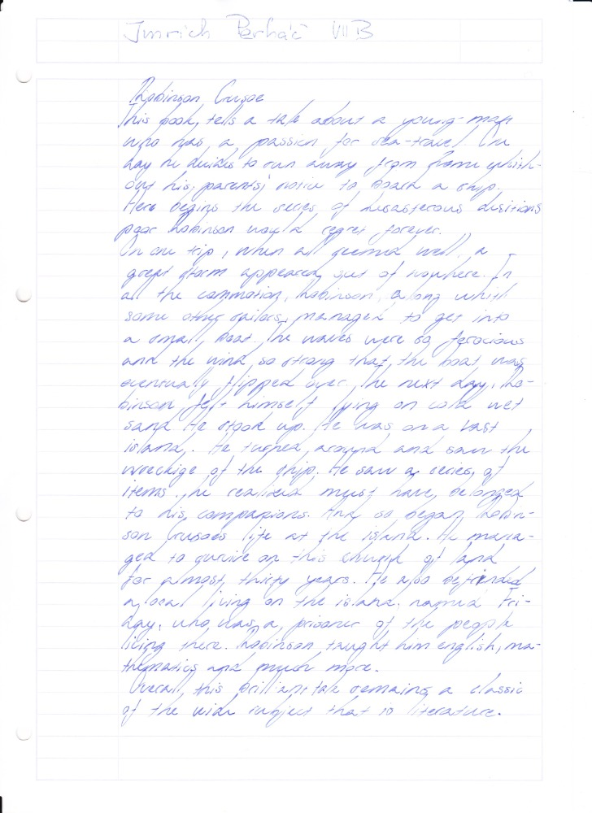
Reading comprehension
Robinson Crusoe
Robinson Crusoe - chapter 18 This chapter was about that Robinson Crusoe was running out of the gunpowder and he has just one last goat. He hasn’t the heard to kill his last goat, but he was so hungry. One day the goat died naturally way. He was thinking about how to kill a goat without using gunpowder. Then he got an crazy idea. He decided to make some traps to catch some goats. It works and he catch 3 goats. He build a fence for them and after a while he had more than 20 goats, which was really nice. So he had a lot of meat and milk. He can also make clothes from the goatskin. He was wearing a jacket and short trousers. He doesn't have any shoes he has just goatskin on his feet. One day he was walking around the island and the he saw something very strange. There was a footprint in the sand. He was so scared, so he ran to his house. He couldn't sleep that night, but the he realized, that maybe the footprint was from his shoe. This idea helps him a lot. He was going to check the footprint tomorrow.
The man shipwrecked with, his pockets completely empty but a knife and a tobacco.
He went for a walk to find some fresh water. He also made a weapon to protect himself from wild animals. The first night he decided to sleep on a tree.
When he woke up the next morning the sea was really calm. He was surprised to discover that the ship moved.
Following morning he took off his clothes and swam to the boat. There was no easy way to get aboard, so he swam around the boat twice. Than he saw a rope witch hanging on the side. He went to the kitchen and filed his pockets with biscuits. He was lucky that some of the food was dry. Then, he took boards and made a raft to carry the things to the beach.
Suddently, he heard something and went to look for what it was. It was a dog and now he wasn't lonely anymore. Then, he started looking for clothes, because the tide was getting very high and all his clothes left on the beach were already in the water.
He also found a box with tools. He took also some guns and a gunpowder to protect himself. When he came back to the beach he started looking where he could stay. He saw a hill and realized, that from the hill he could see where he was. However, when on the top of the hill, he saw, that there was water all around him and that he is on the island.
He could also see two small islands nearby. One was to the north. One was to the west. He also saw a big land to the south. It was far. He didn't saw anything to the east. He saw only the blue ocean.
tobacco tabák
sunset západ slunce
stick klacek
hanging viset
climb lézt
biscuits sušenky
boards desky
noticed všimnout
tide slapy
blowing foukat
sign podpis

Slide 9

I AM PROUD OF YOU!!!
GREAT JOB, PUPILS!!!!

